Slide 1
Software Architecture Evaluation
Lecturer: Ngo Huy Bien
Software Engineering Department
Faculty of Information Technology
VNUHCM - University of Science
Ho Chi Minh City, Vietnam
nhbien@fit.hcmus.edu.vn

Slide 2

Objectives
To present why software architecture evaluation.
To present ATAM and CBAM method.

Slide 3

Contents
Software Architecture Evaluation.
Scenarios Based Evaluation.
Architecture Tradeoff Analysis Method (ATAM).
Chemical Abstract Machine.
Metric Based Evaluation.

Slide 4

References
Banani Roy and T.C. Nicholas Graham (2008). Methods for Evaluating Software Architecture : A Survey.
Rick Kazman, Mark Klein and Paul Clements (2000). ATAM: Method for Architecture Evaluation.
R. Kazman, M. Klein and P. Clements (1998). Evaluating Software Architectures for Real-Time Systems.
Rick Kazman, Jai Asundi and Mark Klein (2002). Making Architecture Design Decisions: An Economic Approach.
Debra J. Richardson and Alexander L. Wolf (1996). Software Testing at the Architectural Level.
Jan Bosch and Peter Molin (1999). Software Architecture Design Evaluation and Transformation.

Slide 5
Software Architecture Evaluation [1]
One of the solutions to cope with architectural mistakes is to evaluate the software architecture of a software system against the problem statements and the requirement specifications. (WHY)
Software architecture evaluation is a technique or method which determines the properties, strengths and weaknesses of a software architecture or a software architectural style or a design pattern. (WHAT)
Software architectural evaluation provides assurance to developers that their chosen architecture will meet both functional and non-functional quality requirements. (WHY)
The main two opportunities for evaluation are before and after implementation. (WHEN)

Slide 6

Why Software Architecture Evaluation? [2]
If a software architecture is a key business asset for an organization, then architectural analysis must also be a key practice for that organization. Why?
Because architectures are complex and involve many design tradeoffs.
Without undertaking a formal analysis process, the organization cannot ensure that the architectural decisions made — particularly those which affect the achievement of quality attribute such as performance, availability, security, and modifiability — are advisable ones that appropriately mitigate risks.

Slide 7

Who Evaluates Software Architecture? [3]
Stakeholders: coders, integrators, testers, maintainers, and so forth.
Stakeholders articulate the specific requirements that are levied on the architecture, above and beyond the requirements that state what functionality the system is supposed to exhibit.
Project decision-makers: architect, designers of components, and project’s management.
Evaluation team. These are the people who will conduct the evaluation and perform the analysis.

Slide 8

What Does the Evaluation Produce?
In concrete terms, an architecture evaluation produces a report.
In particular, it produces answers to the following kinds of questions:
Is this architecture suitable for the system for which it was designed?
Which of two or more competing architectures is the most suitable one for the system at hand?

Slide 9


Slide 10

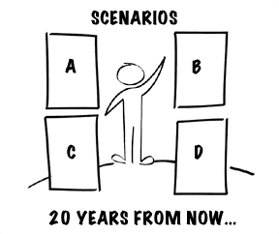
Scenarios Based Evaluation

Slide 11
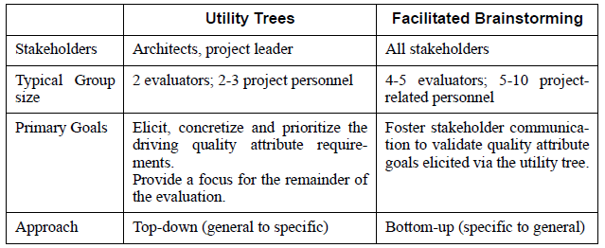
Scenarios for Evaluation
Scenarios are elicited and prioritized in ATAM using different mechanisms at different times with different stakeholder participation.
The two mechanisms employed are utility trees and structured brainstorming.

Slide 12
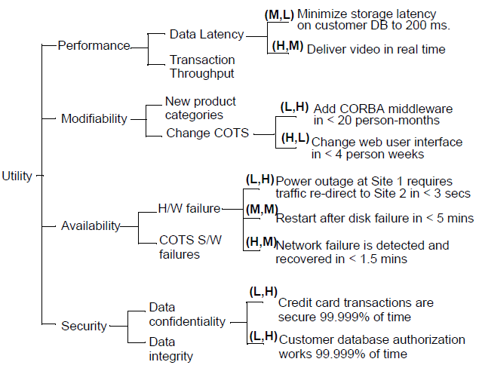
A Sample Utility Tree

Slide 13
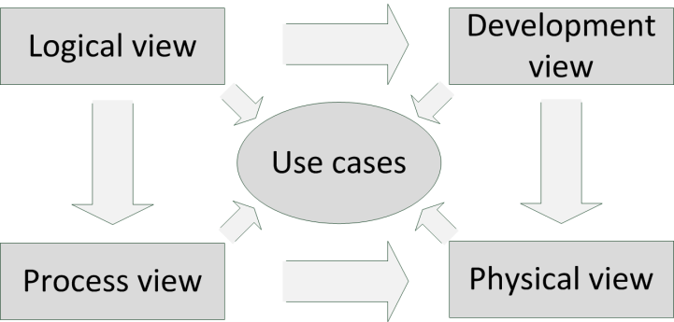
Architectural Information for Evaluation
Kruchten’s “4+1 views”

Slide 14
Architectural Style
An architectural style includes a description of component types and their topology, a description of the pattern of data and control interaction among the components, and an informal description of the benefits and drawbacks of using that style.
By locating architectural styles in an architecture, we see what strategies the architect has used to respond to the system’s driving performance goals, modifiability goals, availability goals, and so forth.

Slide 15
Attribute-Based Architecture Styles
The ATAM uses a particular specialization of this called attribute-based architectural styles, or ABASs.
An ABAS is an architectural style in which the constraints focus on component types and patterns of interaction that are particularly relevant to quality attributes such as performance, modifiability, security, or availability.

Slide 16
Attribute-Based Architecture Styles [3]
We define an ABAS as having four parts:
Problem Description: what problem is being solved by this structure,
Stimuli/Responses: a characterization of the stimuli that this ABAS is designed to respond to, and a description of the quality attribute-specific measures of the response,
Architectural Style: the set of component and connector types, the topology, a description of the patterns of data and control interaction among the components (as in the standard definition of an architectural style), and any properties of the components or connectors that are germane to the quality attribute,
Analysis: a quality attribute specific model that provides a method of reasoning about the behavior of component types that interact in the defined pattern.

Slide 17
Architecture Tradeoff Analysis Method (ATAM) [2]
The ATAM is meant to be a risk identification method, a means of detecting areas of potential risk within the architecture of a complex software intensive system.
The purpose of the ATAM is to assess the consequences of architectural decisions in light of quality attribute requirements.
We are not attempting to precisely predict quality attribute behavior.
What we are interested in doing is learning where an attribute of interest is affected by architectural design decisions, so that we can reason carefully about those decisions, model them more completely in subsequent analyses, and devote more of our design, analysis, and prototyping energies on such decisions.

Slide 18
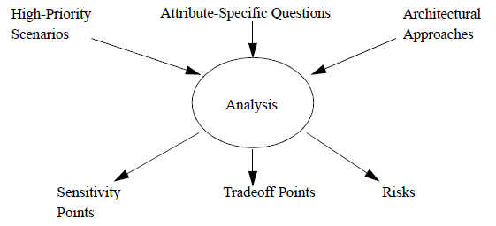
The Outputs of the ATAM
Risks are potentially problematic architectural decisions.
Non-risks are good decisions that rely on assumptions that are frequently implicit in the architecture.
A sensitivity point is a property of one or more components (and/or component relationships) that is critical for achieving a particular quality attribute response.
A tradeoff point is a property that affects more than one attribute and is a sensitivity point for more than one attribute.

Slide 19
A Structure for Reasoning
The reasoning is not always highly formal and mathematical, but it must be predictive and repeatable.
The reasoning might manifest itself as a discussion that follows from the exploration the architectural approaches that address a scenario;
it may be a qualitative model of attribute-specific behavior of the architecture; or
it may be a quantitative model that represents how to calculate a value of a particular quality attribute.
ABASs and quality attribute characterizations provide the technical foundations for creating these reasoning models.

Slide 20
Step 1 - Present the ATAM
the ATAM steps in brief
the techniques that will be used for elicitation and analysis: utility tree generation, architectural approach-based elicitation/analysis, and scenario brainstorming/mapping
the outputs from the evaluation: the scenarios elicited and prioritized, the questions used to understand/evaluate the architecture, a “utility” tree, describing and prioritizing the driving architectural requirements, the set of identified architectural approaches and styles, the set of risks and non-risks discovered, the set of sensitivity points and tradeoffs discovered

Slide 21
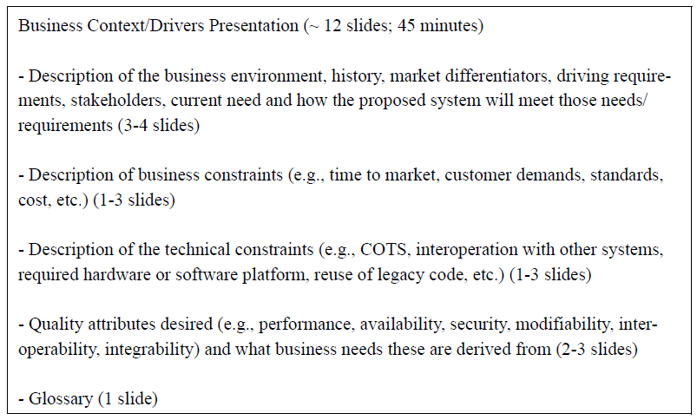
Step 2 - Present the Business Drivers
The project manager presents a system overview from a business perspective.

Slide 22
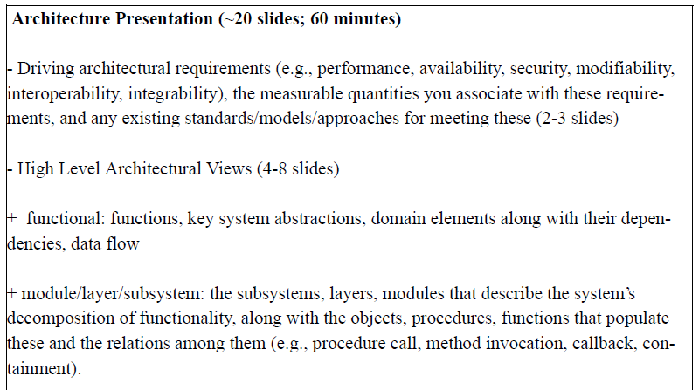
Step 3 - Present the Architecture
The architecture will be presented by the lead architect (or architecture team) at an appropriate level of detail.

Slide 23
Step 4 - Identify Architectural Approaches
The ATAM focuses on analyzing an architecture by understanding its architectural approaches.
In this step they are identified by the architect, and captured by the analysis team, but are not analyzed.
These architectural approaches define the important structures of the system and describe the ways in which the system can grow, respond to changes, withstand attacks, integrate with other systems, and so forth.

Slide 24
Step 5 - Generate Quality Attribute Utility Tree
The evaluation team works with the architecture team, manager, and customer representatives to identify, prioritize, and refine the system’s most important quality attribute goals.
The output of the utility tree generation process is a prioritization of specific quality attribute requirements, realized as scenarios.
This prioritized list tells the ATAM team where to spend its limited time, and in particular where to probe for architectural approaches and their consequent risks, sensitivity points, and tradeoffs.

Slide 25
Step 6 - Analyze Architectural Approaches
The major outputs of this phase are a list of architectural approaches or styles, the questions associated with them, and the architect’s response to these questions.
The evaluation team and the architecture team address each architectural approach presented by asking a set of approach-specific and quality-attribute-specific questions.
These questions might come from documented experience with styles (as found in ABASs and their associated quality attribute characterizations), from books on software architecture, or from the prior experiences of the assembled stakeholders.
Each question is a starting point for discussion, and for the determination of a potential risk, non-risk, sensitivity point, or tradeoff point. These, in turn, may catalyze a deeper analysis, depending on how the architect responds.

Slide 26
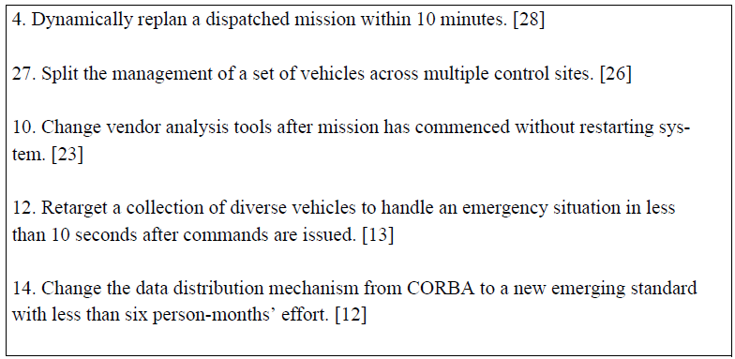
Step 7 - Brainstorm and Prioritize Scenarios

Slide 27
Step 8 - Analyze Architectural Approaches with Scenarios
After the scenarios have been collected and so analyzed, the architect then begins the process of mapping the highest ranked scenarios onto whatever architectural descriptions have been presented.
Ideally this activity will be dominated by the architect’s mapping of scenarios onto previously discussed architectural approaches.
In fact the whole point of the hiatus between the two phases is to ensure that this is the case.
If this is not the case then either the architect has no approach- or style-based (and hence no architecture-wide) solution for the stimulus that the scenario represents, or the approach exists but was not revealed by any activities up until this point.

Slide 28
Step 9 - Present Results
the architectural approaches/styles documented
the set of scenarios and their prioritization
the set of attribute-based questions
the utility tree
the risks discovered
the non-risks documented
the sensitivity points and tradeoff points found
The results are improved architectures, based on subjective judgment influenced by the participants' experience.

Slide 30
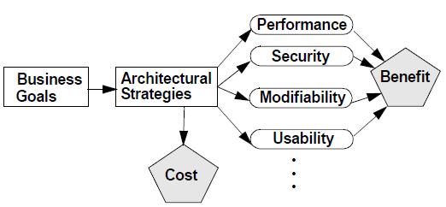
Cost Benefit Analysis Method Context [4]
The software architect or decision maker needs to maximize the difference between the benefit derived from the system and the cost of implementing the design.
The CBAM begins where the ATAM concludes and depends on the artifacts produced by the ATAM.
The ATAM uncovers the architectural decisions made in the system and links them to business goals and QA response measures.
The CBAM builds on this foundation by eliciting the costs and benefits associated with these decisions.

Slide 31
Iteration I: Establish an Initial Ranking (I)
Step 1: Collate scenarios.
Step 2: Refine scenarios.
Elicit the worst, current, desired, and best-case QA response level for each scenario.
Step 3: Prioritize scenarios.
Allocate 100 votes to each stakeholder and have them distribute the votes among the scenarios by considering the desired response value for each scenario.
Step 4: Assign utility.
Determine the utility for each QA response level (worst-case, current, desired, or best-case) for all scenarios.

Slide 32
Iteration I: Establish an Initial Ranking (II)
Step 5: Develop ASs for scenarios and determine their expected QA response levels.
Step 6: Determine the utility of the expected QA response level by interpolation.
Step 7: Calculate the total benefit obtained from an AS.
Step 8: Choose ASs based on ROI, subject to cost and schedule constraints.
Step 9: Confirm the results with intuition.

Slide 33
Iteration II: Incorporating Uncertainty
The CBAM relies on stakeholder judgments for its valuations of software benefits and costs.
But these judgments will naturally be uncertain, due to differences in beliefs and experiences.
One way to think rigorously about the uncertainty of the results collected in Iteration I is to collect and consider the risks inherent in the estimates that have been made.
The stakeholders need to assess the probability and impact of each risk and use this to create a delta expected cost, delta expected response, and utility value for each risk affecting each AS.
The final result of this iteration is to associate with each cost, response, and utility a range (distribution) of values, rather than a single point value for each.

Slide 35
Chemical Abstract Machine [5]
The Chemical Abstract Machine is a term rewriting formalism that leads to a description of an architecture as a set of static components (the "molecules") whose states and interactions are governed by transformation rules (the "re-actions").
A Chemical Abstract Machine is specified by defining molecules m₁, m₂, … and solutions S₁, S₂, … of molecules.
Molecules constitute the basic elements of a CHAM, while solutions are multi-sets of molecules interpreted as defining the states of the CHAM.
A CHAM specification also contains transformation rules T₁, T₂, ... each defining a transformation relation S₁ → S₂, dictating the way solutions can evolve (i.e., states can change) in the CHAM.

Slide 36
Molecules / Transformation Rules
Molecules are defined as terms of a syntactic algebra that derive from a set of constants and a set of operations defined for a specific CHAM.
For architecture specification, these sets would include a set D representing the data elements, a set P representing the processing elements, and a set C representing the connecting elements.
The transformation rules can be of two kinds: general laws that are valid for all CHAMs and specific rules defined for the particular CHAM being specified.

Slide 37
Architecture-based Testing with CHAM
Just as an individual unit's implementation and specification consist of data, statements or assertions, and control, an architecture is similarly composed of data elements, processing elements, and connecting elements.
These elements as well as the complex of relationships among the elements should be exercised to adequately test the architecture.
The CHAM for a software architecture defines molecules (elements), solutions (combinations of elements) and transformations between solutions all of which should be exercised during testing at the architectural level.

Slide 38
Architecture-Based Testing Process
Basically, applying any one of our CHAM-based criterion proceeds as follows
(1) it determines the set of structures to be covered by the test plan
(2) it specifies a set of "paths" through the architecture that cover these structures, where each "path" is the set of solutions generated; and
(3) it defines test data in terms of the architecture's interaction with the outside world that would cause this set of solutions to be generated.

Slide 39
Architecture-Based Test Criteria
all-data-elements
for each data element d at least one solution contains a molecule involving d
all-processing-elements
for each processing element p at least one solution contains a molecule involving p
all-connecting-elements
all-transformations
all-transformation-system
all-data-dependences

Slide 41
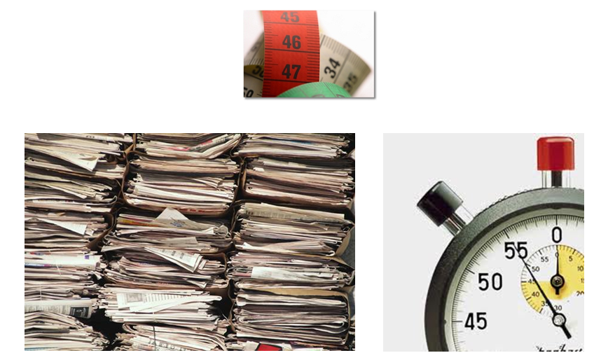
Metric Based Evaluation

Slide 43
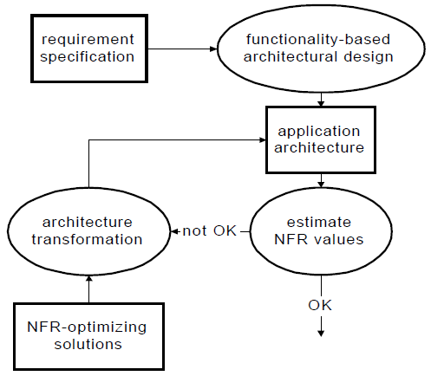
Architectural Design Method [6]

Slide 44
Functionality-Based Architecture
The main issue during this phase is to identify the core abstractions based on which the system is structured.
Although these abstractions are modeled as objects, our experience is that these objects are not found immediately in the application domain.
Instead, they are the result of a creative design process that, after analyzing the various domain entities, abstracts the most relevant properties and models them as architecture entities.
Once the abstractions are identified, the interactions between them are defined in more detail.
The architecture of a system generally covers multiple domains.

Slide 45
Estimating Non-Functional Requirements Values
Scenario-based evaluation
The quality of the assessment is strongly related to the objective judgment of the engineer ‘running’ the scenarios.
Simulation
The main components of the architecture are implemented and other components are simulated resulting in an executable system.
Mathematical modeling
The mathematical models allow for static evaluation of architectural design models.
Objective reasoning
The ‘feeling’ that something was wrong. This approach may form the basis for the other evaluation approaches.

Slide 46

Thank You & See You Again

